Slide 1
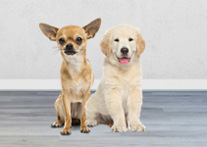
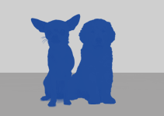

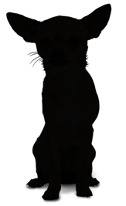




Object Detection
 | Result | Output Level | Instant Detect | All Areas Output | Models
Image Classification |  | Image | ✖ | 〇 | VGG ResNet Inception MobileNet DenseNet
Image Classification Localization |  | Box | ✖ | ✖ | HOG BOF PASCAL VOC
Object Detection |  | Box | 〇 | ✖ | R-CNN Fast R-CNN SDD YOLO RetinaNet
Semantic Segmentation |  | Pixel | ✖ | 〇 | U-NET MULTISCALE HYBRID CNN-CRF
Instant Segmentation |  | Pixel | 〇 | ✖ | Mask R-CNN DeepMask FCIS
Panoptic Segmentation |  | Pixel | 〇 | 〇 | Panoptic Feature Pyramid Network UPSNet
Dog 98%
Dog 93%
Dog 93%
Dog 97%
https://jingwora.github.io/

Slide 2
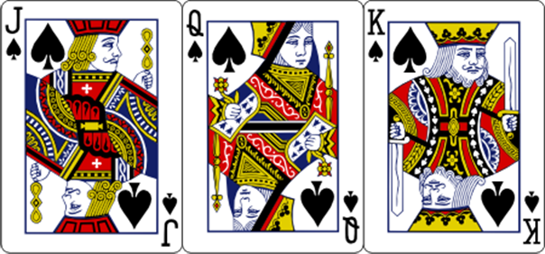


Slide 3
















PYSPARK
SKLEARN

Slide 4



Slide 5
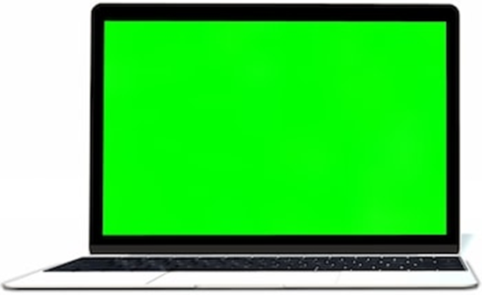
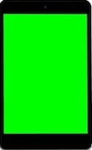
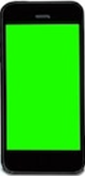

Slide 6
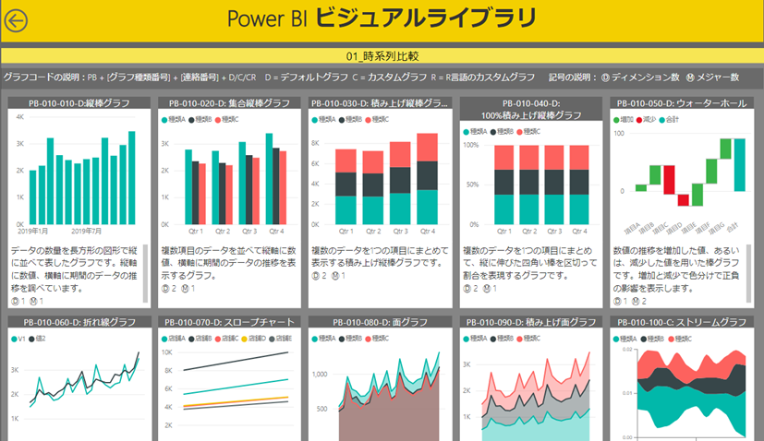
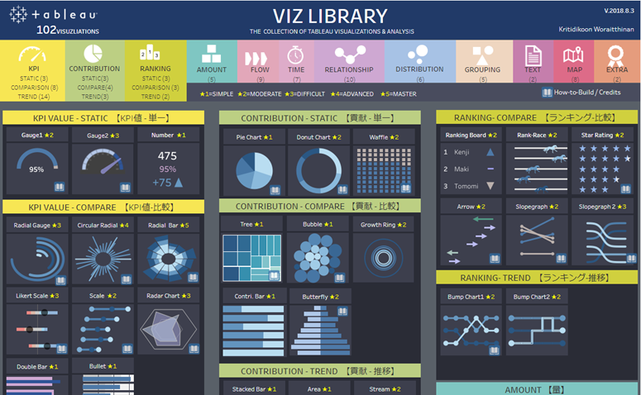
https://community.powerbi.com/t5/Data-Stories-Gallery/PowerBI-Visual-Library/td-p/998398

Slide 7





Slide 8














ENVIRONMENT
DEV
SERVER
USER
VS CODE
Colab
Tensorflow.js
Tensorflow.js
Local + Cloud
GitHub Pages: static site
AI at the Edge

Slide 9


Slide 10


Slide 11




Data Analysis
Data Science
Data Engineer
Web Developer

